Slide 1

DISPLACEMENT DEVICE FOR ION EXTRACTION IN LXe
Ryan Elmansali
Supervisor: Dr. Razvan Gornea
CAP 2023

Slide 2
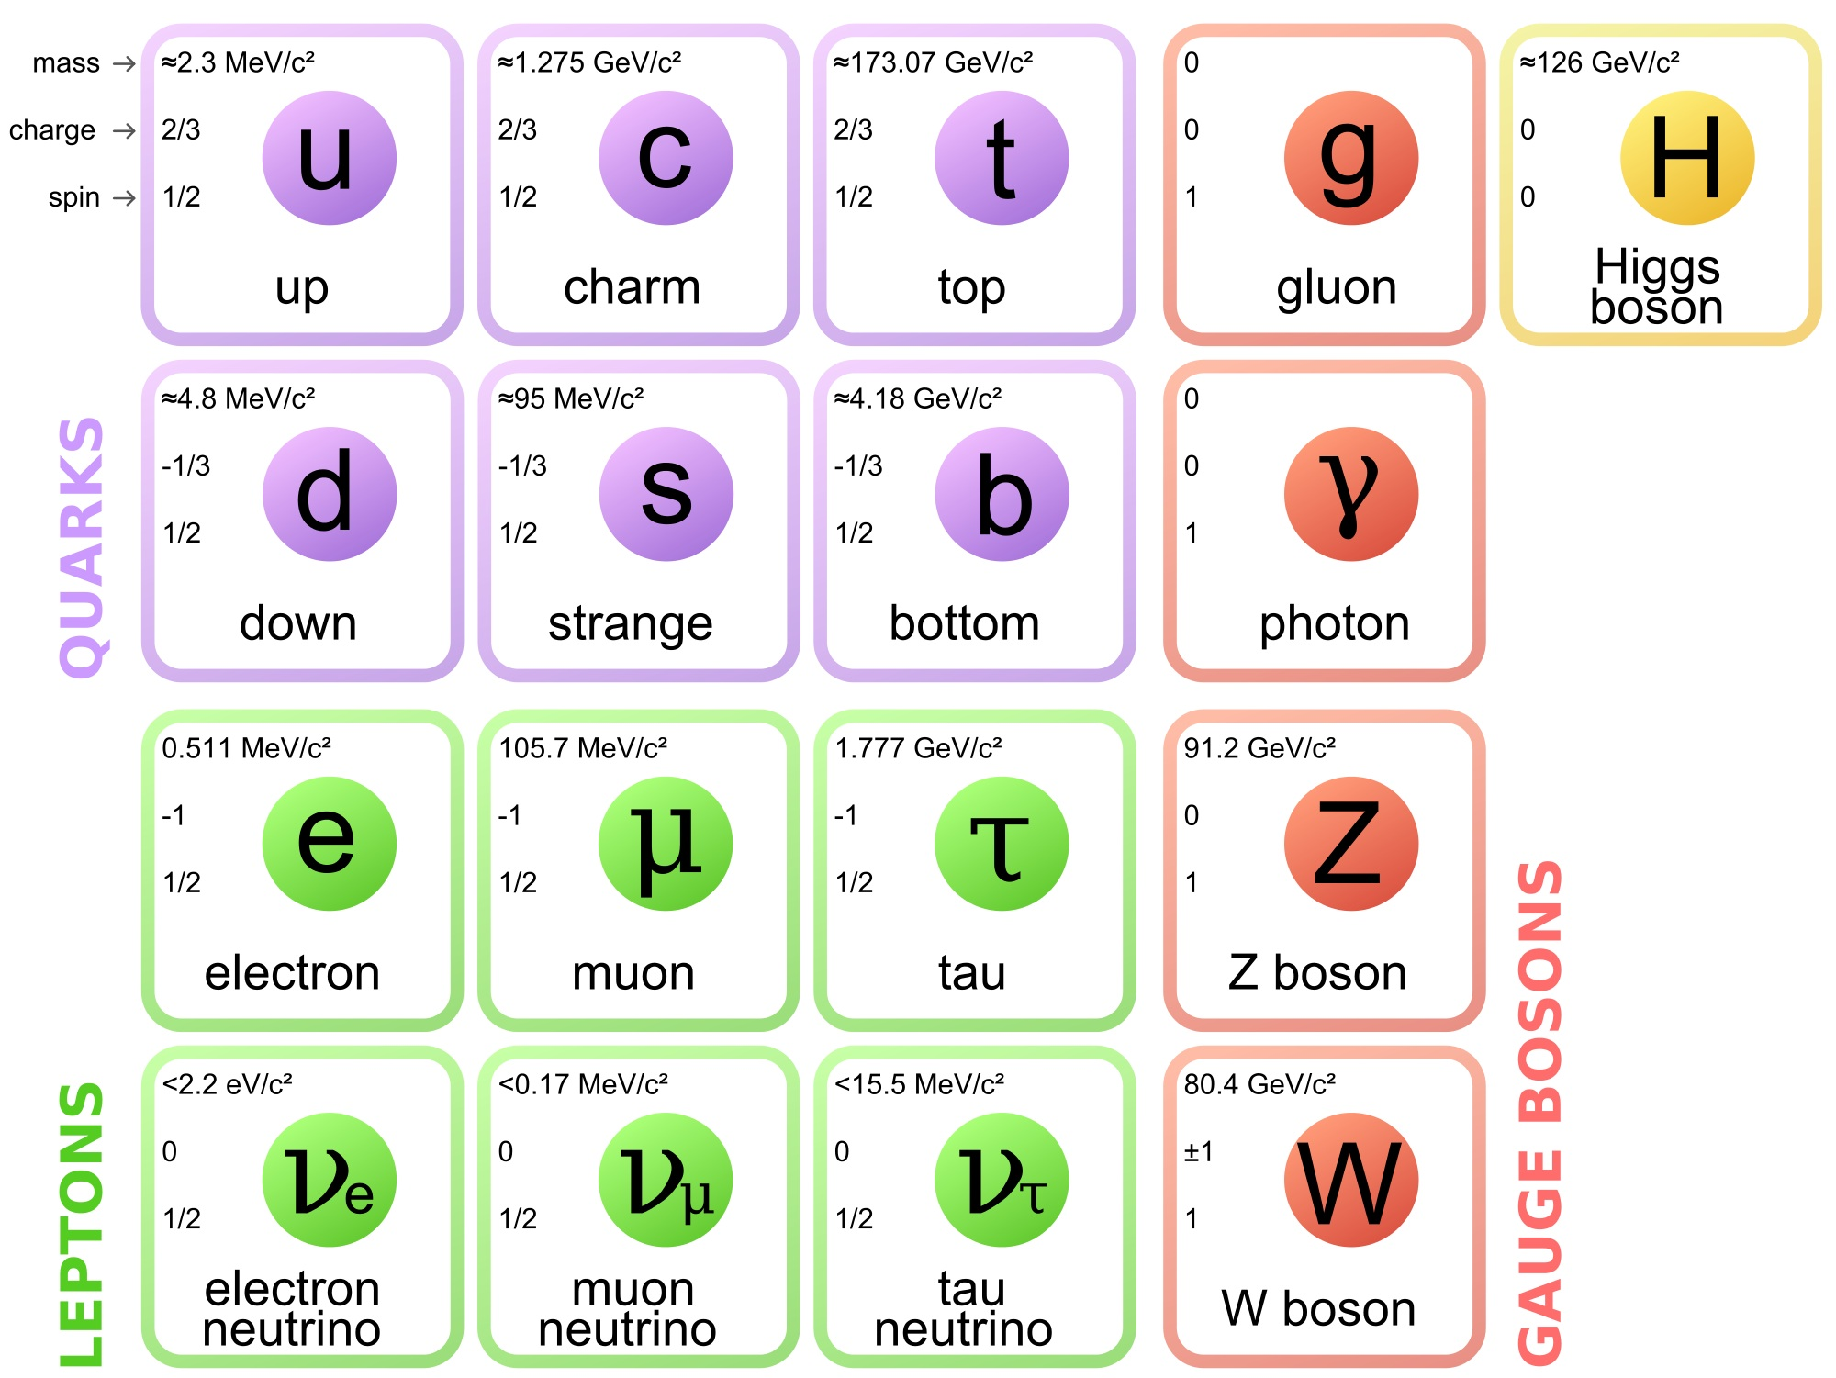
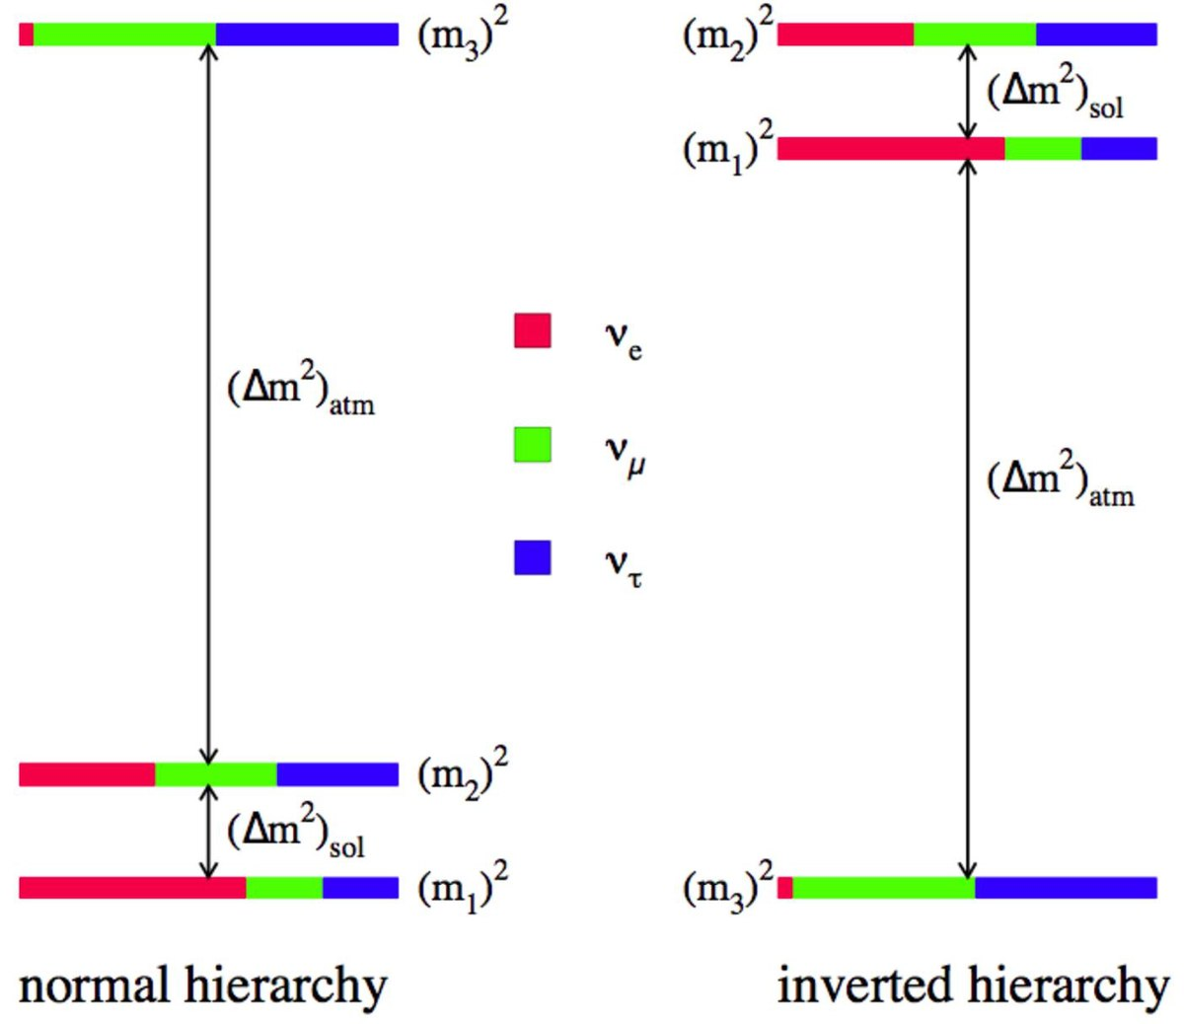
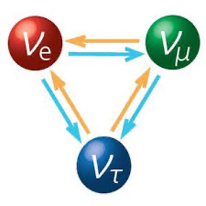
Neutrinos
Absolute mass and ordering (mass hierarchy) remains unknown.
Neutrinos come in 3 "flavours": ν_{e}, ν_{μ}, ν_{τ}
They change flavour as they propagate (neutrino oscillation)
Neutrinos are massive!

Slide 3
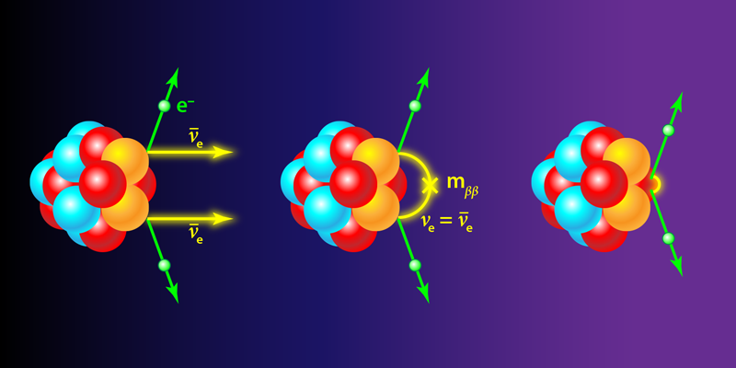
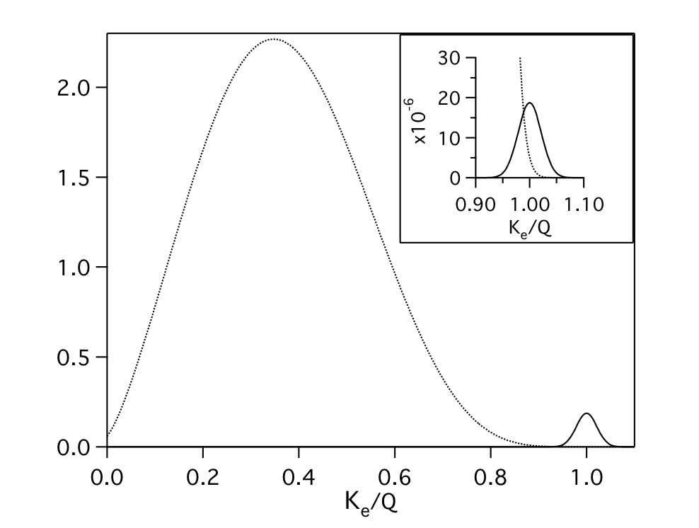
Neutrino-less Double Beta Decay
Neutrino-less: 2n 2p + 2e⁻
Only possible if neutrinos are Majorana
Want to observe 0νββ since Decay rate is related to neutrino mass
2νββ
0νββ

Slide 4
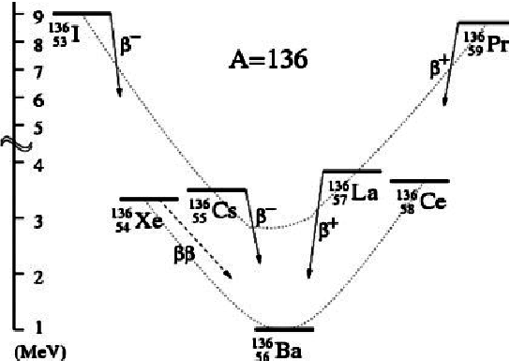
Barium Tagging
Identification of the Ba daughter in Xe neutrino-less double beta decay
Ba ion collection occurs at the decay location
Rejects all radioactive backgrounds but not 2νββ
Tagging has many steps, beginning with the physical collection of a single Ba⁺ in LXe
¹³⁶Xe ¹³⁶Ba + 2e⁻
Identify this!

Slide 5
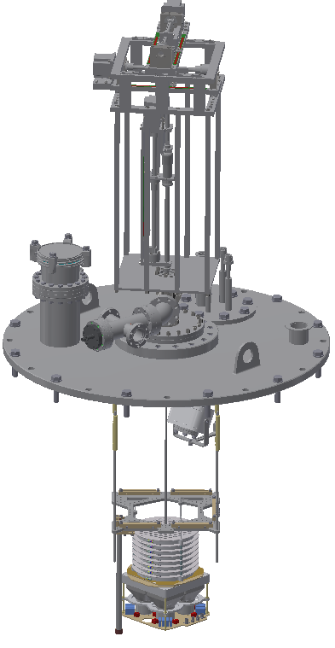
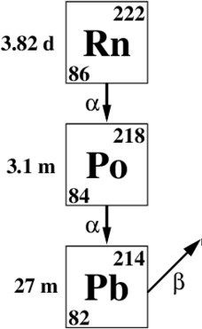
Ion extraction at Carleton
Dissolved in LXe
Displacement device
Distinctive signature detected by TPC; location determined for extraction
Wobblestick
PIPS detector chamber
Ion extracted by capillary, transported to PIPS detector
with high efficiency
Capillary probe
Decay identified by energy deposited in PIPS
TPC

Slide 6
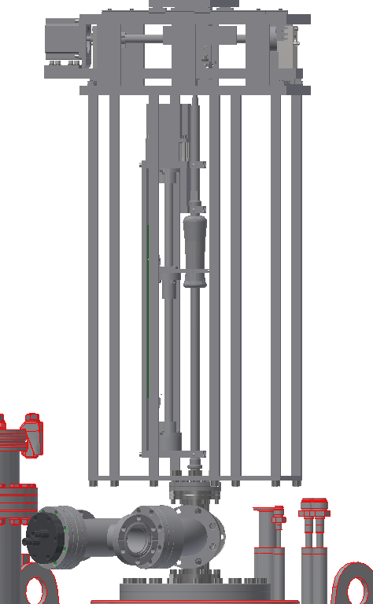
Displacement device
X-Y Stage
Ion extraction requires fast, controlled and precise manipulation of the probe tip
Developed a 2-stage, stepper motor driven device which allows for positioning accurate to 0.1mm in each axis at speeds up to 15 mm/s
Insert/Retract Stage
WS40 manipulation moves probe tip

Slide 7
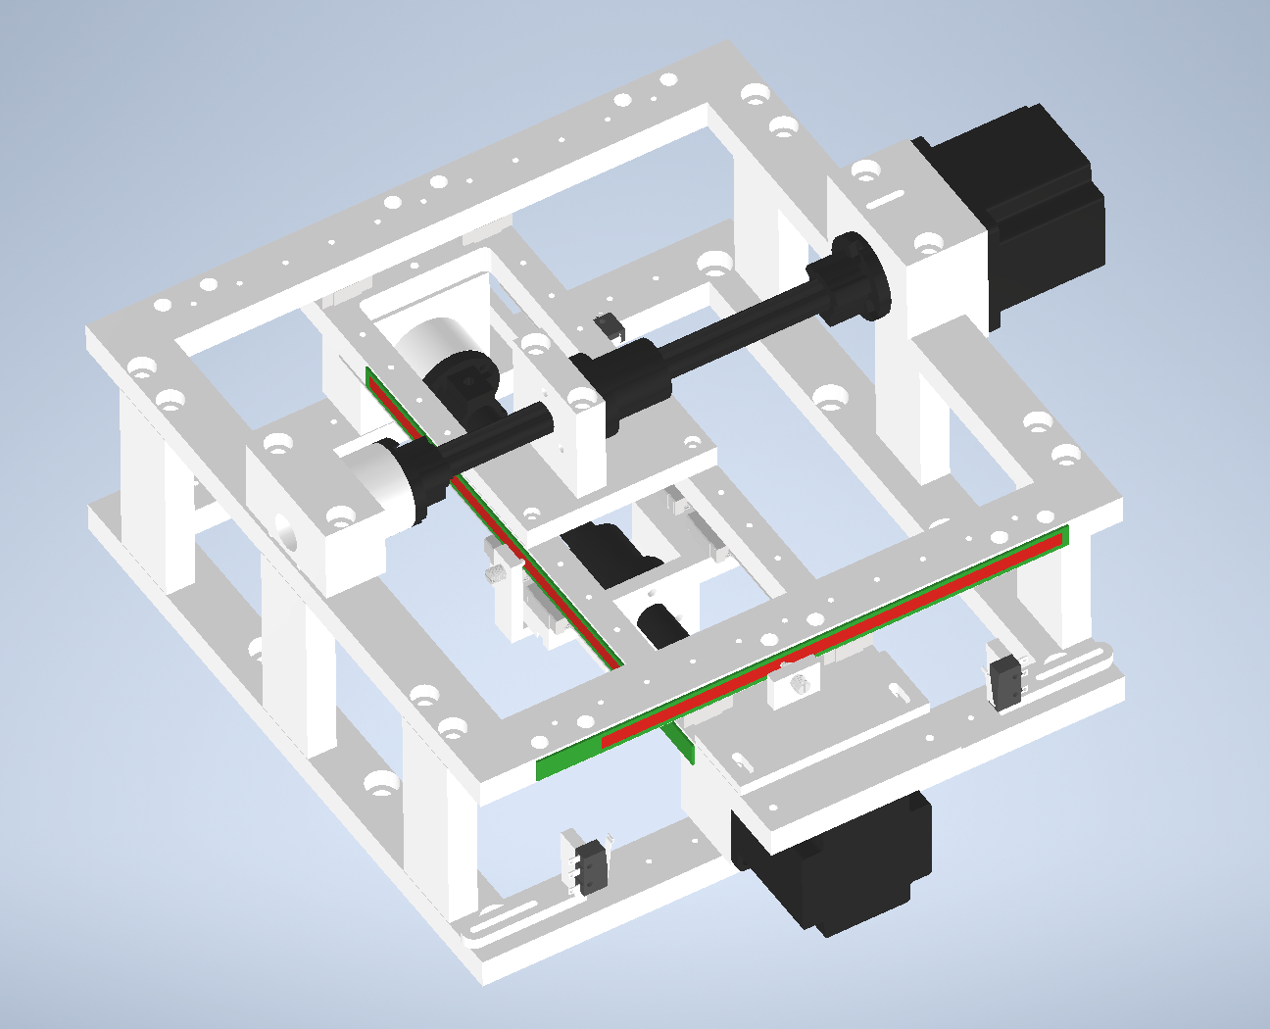
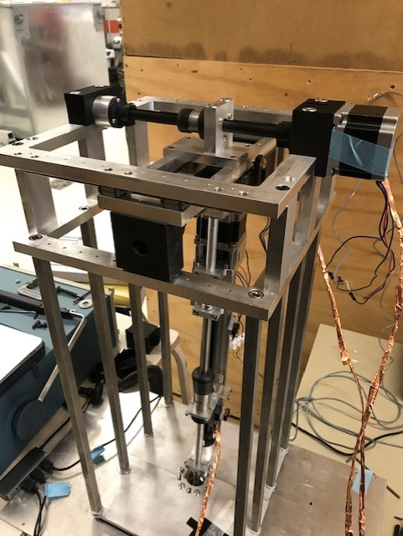
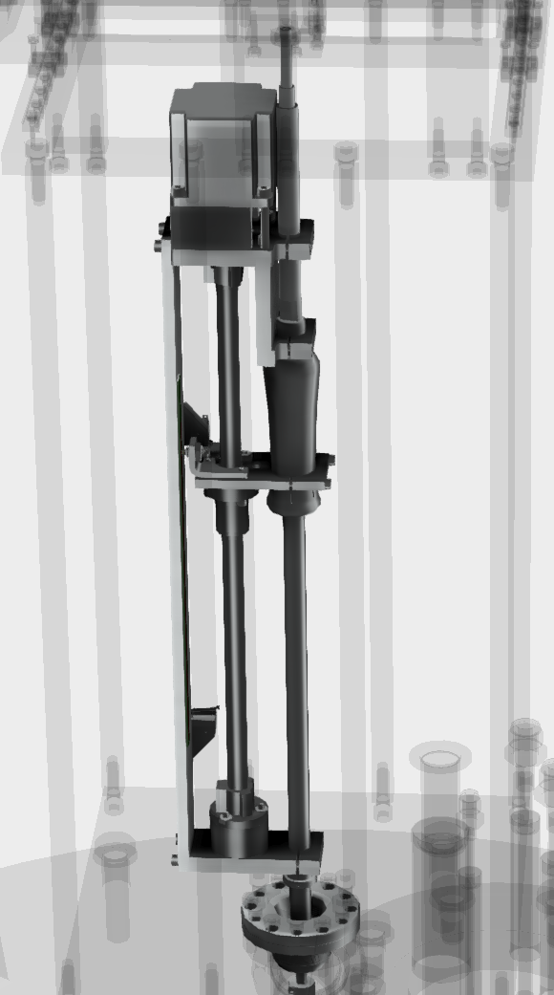
X-Y stage sets angle around WS pivot
Third motor controls insertion/retraction through openings in TPC cathode

Slide 8
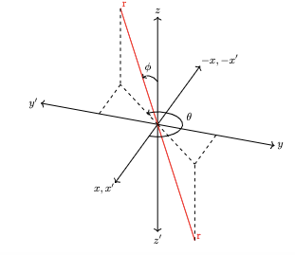
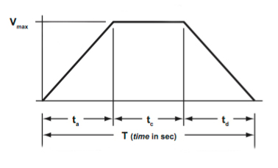
Optimal Motor Kinematics Delivery
Developed software that delivers fast and smooth motion
User need only to provide destination coordinates along with an execution time
Firmware achieves this by calculating necessary delay time between steps in real time
Coordinates passed to software after event reconstruction

Slide 9
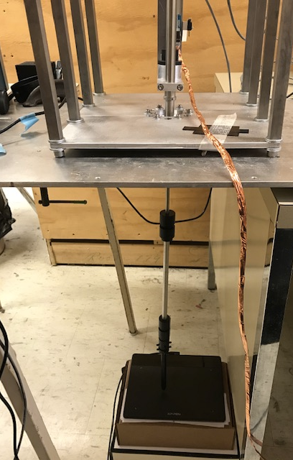
Performance
3D motion tests done by using an electronic track pad + pen touching specific points on a plane
Physical positions on pad corresponds to cursor location on screen in pixels
Compare programmed destination points with positioning feedback from track pad
Dial indicator testing on each individual axis shows motion is faithful to 0.01 mm

Slide 10
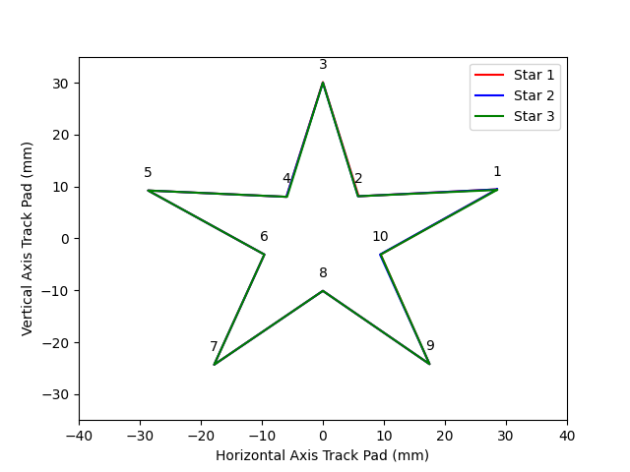
Star Test
Touched ten corners of a star
All points touched are at desired position within resolution of track pad (0.11 mm)
Repeat 3 consecutive times

Slide 11
ION Collection efficiency
Likelihood that a certain event will
be collected by capillary probe ​
Considers:​
Accessibility of event position​
Time to reach event position (3.1 m radioactive ion lifetime)​
Random walk of ion after detection​
Volume collected by probe ​

Slide 12
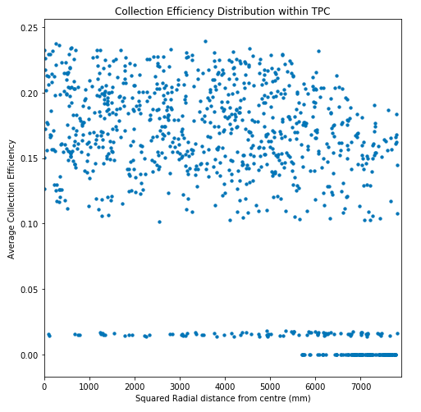
ION Collection Efficiency
Monte Carlo of 1000 points randomly placed inside TPC
Collection process simulated 2500 at each point
Escape and radioactive decay are the loss mechanisms
Low efficiency points: hard to access with probe tip, won’t attempt extraction
Notes:
Plot shows collection efficiency of simulated points randomly distributed within TPC

Slide 13
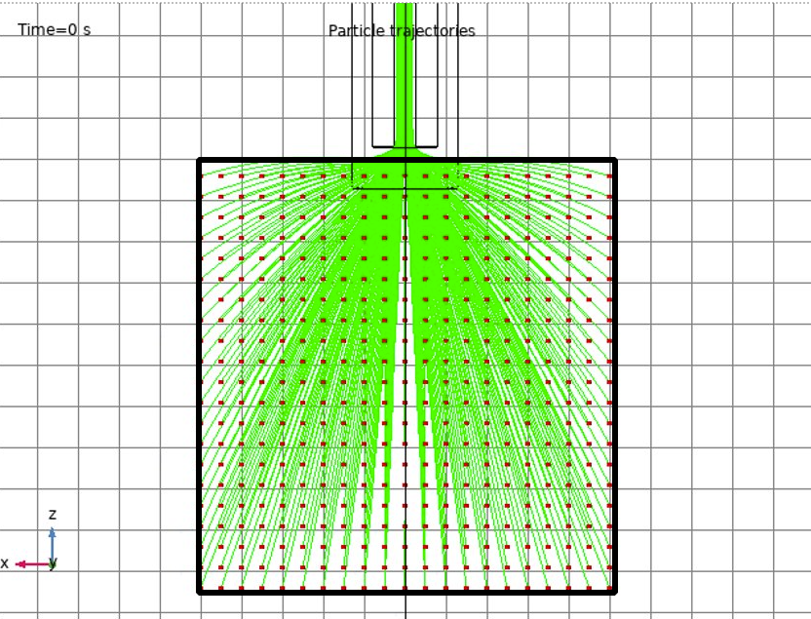
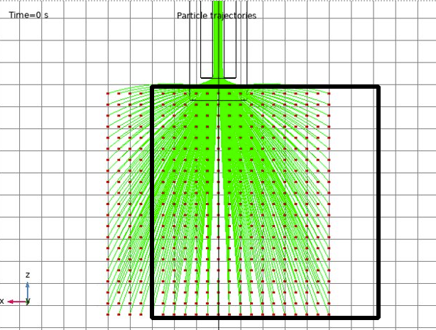
Only 15% of points within TPC are directly accessible by probe tip → allow for a 2.5, 5 or 7mm lateral deviation
90% of points inside TPC are accessible within 8 mm of probe tip
Trade-off individual event collection efficiency to greatly increase total accessible events

Slide 14
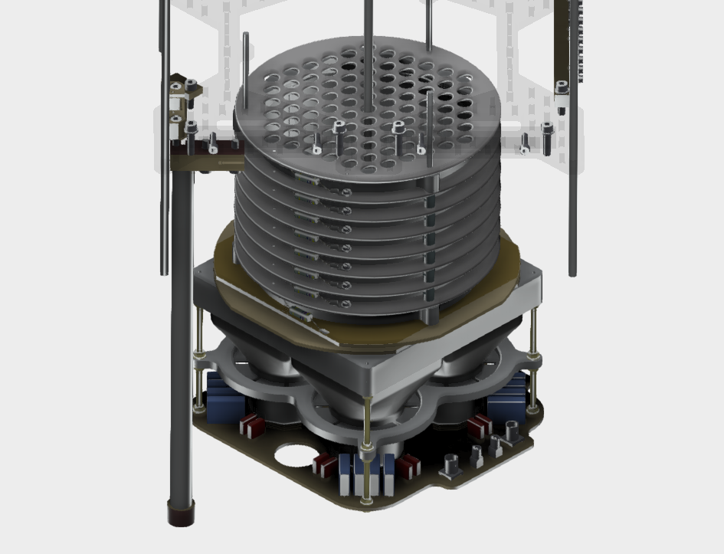
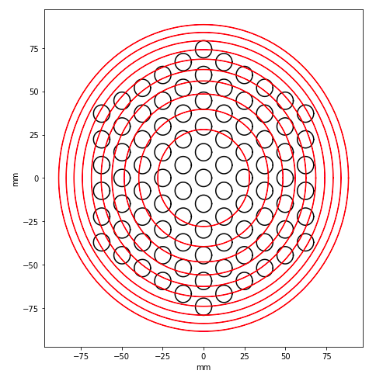
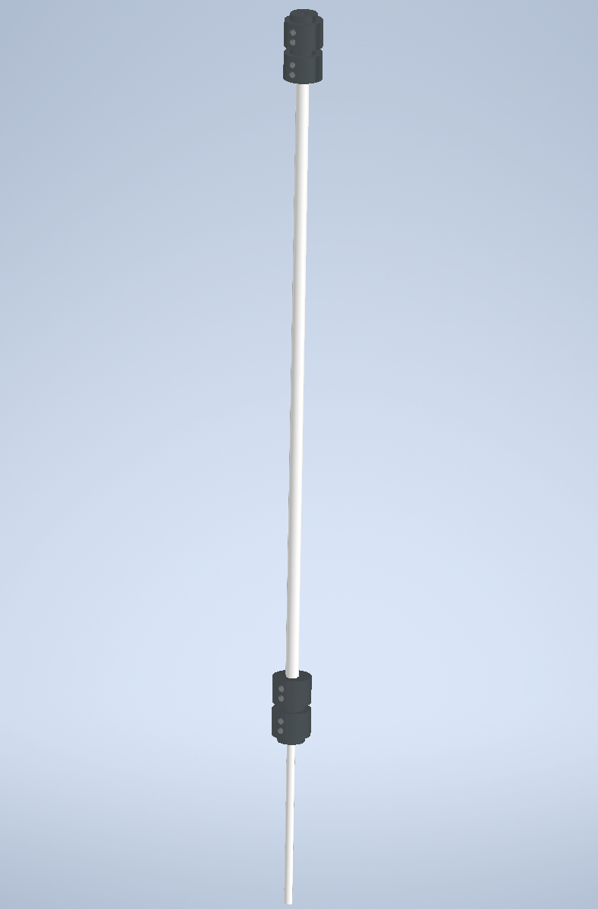
Must enter TPC through one of the cathode holes
Probe has an effective thickness of ¼ inches in diameter
High, outer-ring points are not reasonably reached

Slide 15
Conclusions + Future work
Developed programmable 3D motion device capable of delivering fast, smooth and precise motion
Monte Carlo results show how we can make the most out of our limiting geometry for ion collection
Full targeted extraction later this summer!

Slide 16
Thank you!
Supervisor: Dr. Razvan Gornea
Collaborators: Dr. Robert Collister, Raad Shaikh

Slide 17
Extras

Slide 18
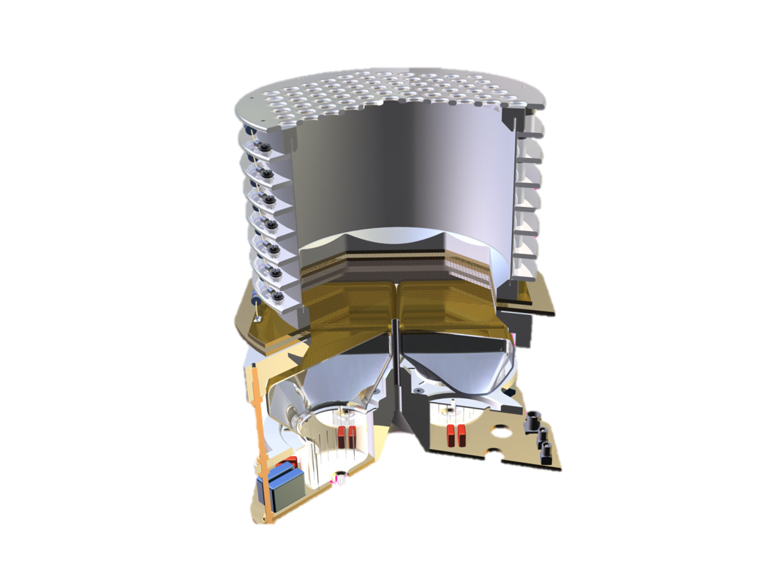
Time Projection Chamber (TPC)
Particle detection device with 3D event reconstruction
Gas or liquid sensitive volume (often inert noble elements)
High energy particles ionize medium
E-field drifts e⁻ to charge collection plane (anode)
PMTs for light collection to detect scintillation photons
e-
e-
e-
e-
e-
e-
Z position reconstruction comes from e⁻ drift timing
Grid segmentation of wires allows for X-Y reconstruction

Slide 19
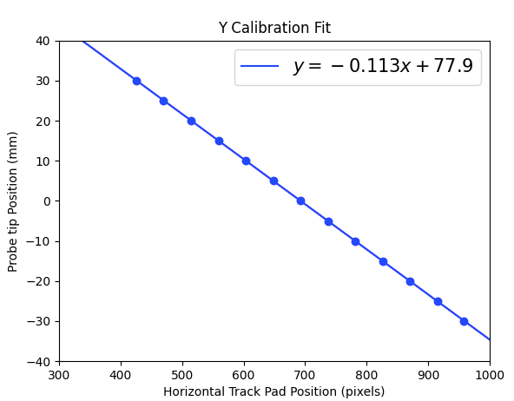
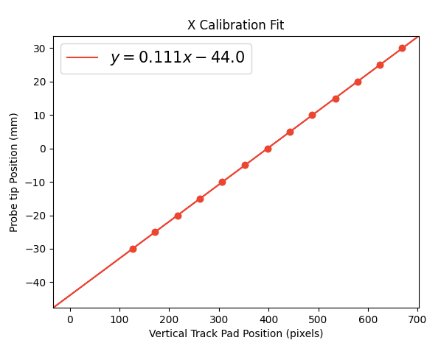
Track Pad Calibration
Each fit is a calibration function that transforms points on track pad to motor coordinate system
Slopes of each function represents the pixels to mm conversion factor for each axis respectively
m_{x-axis} ≠ m_{y-axis} pixels are not square!

Slide 20
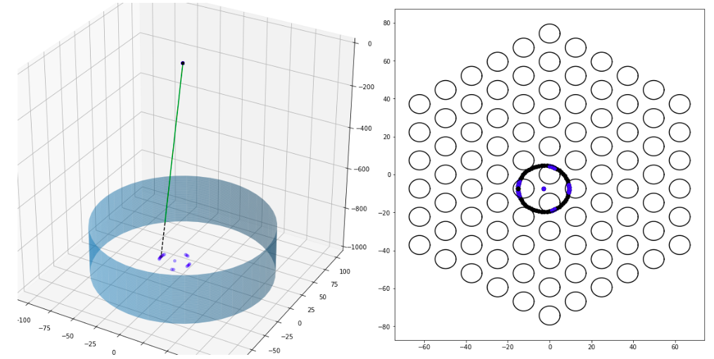
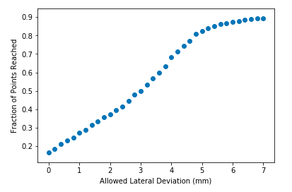
Nonlinear relationship between lateral deviation and accessibility
7mm clearly is taking this alleviation too far
Max out most likely at 5mm

